Slide 1

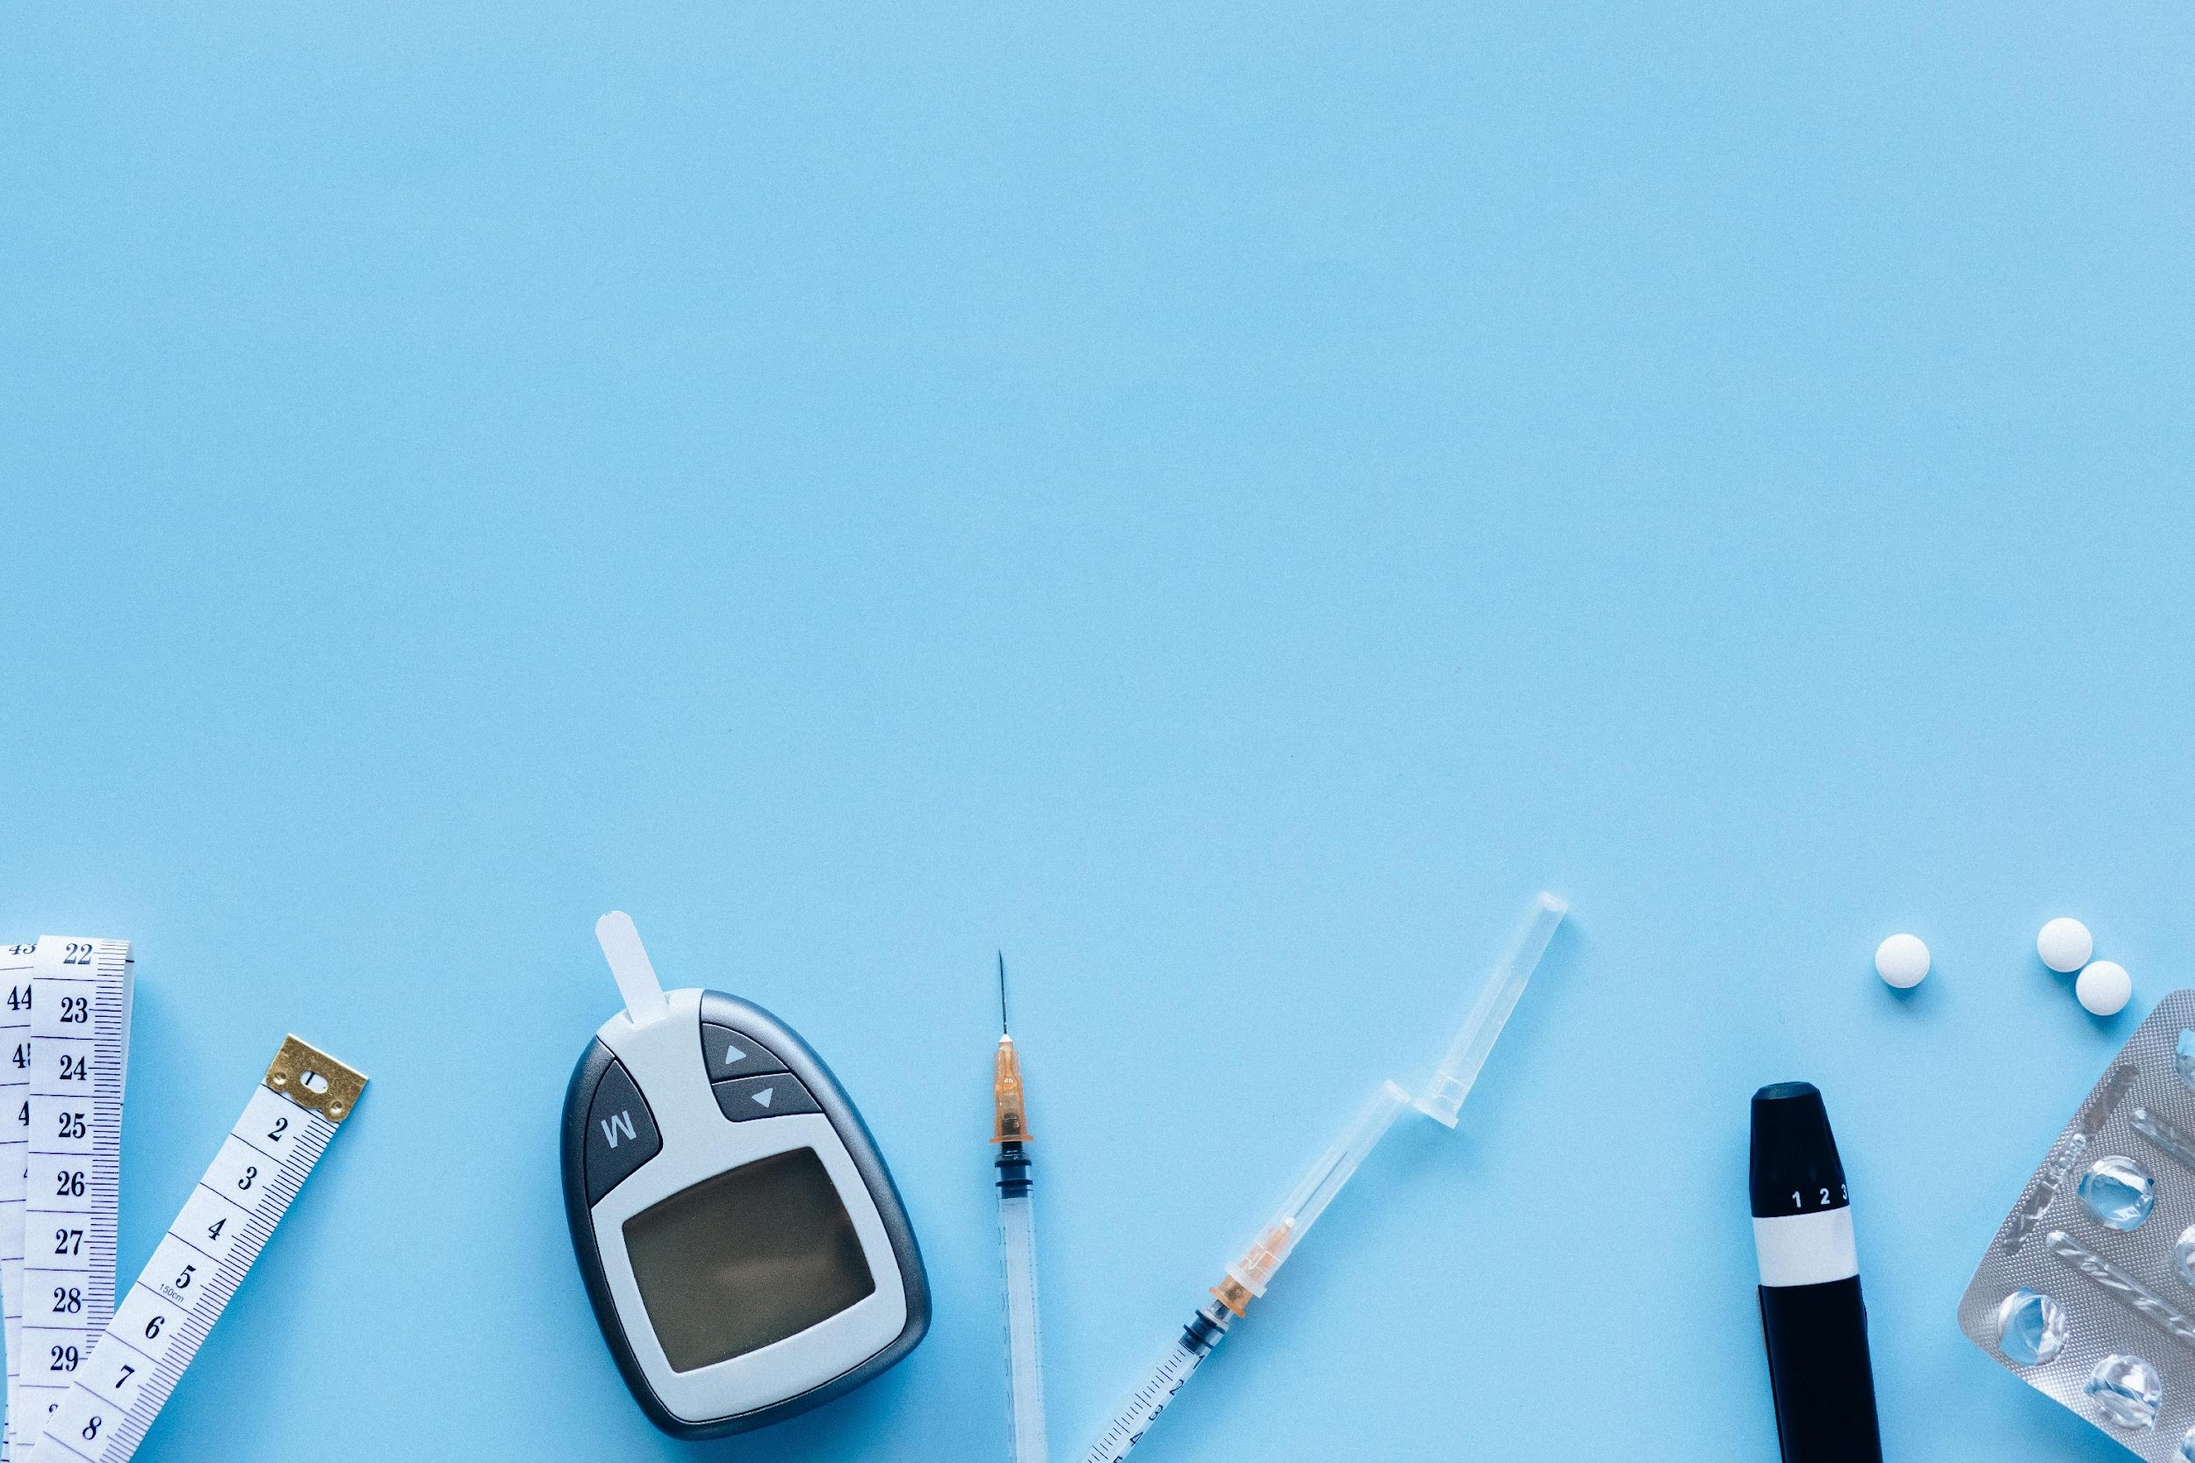
Diabetes Treatment Recommendation system
IT Sohag 2024-2025

Slide 2
Team Members :
Rania Salah Abdel Hamid Ali
2101474
Mohamed Ashraf Aboelfadl Mohamed 2101154
Marina Romany Iskander shokry
2100965
Mostafa Bahaa Yousef Mohamed
2101305
Ahmed Mahmoud Mohamed Seleem 2100325
Renad Ahmed Mohamed Said
2101499
Mohamed Gamal Ahmed Ahmed
2101151
Under Supervision of:
Dr: Amira Idris
Professor at Fayoum University
Eng: Yousif Ayman
Teaching Assistant at EELU Sohag

Slide 3

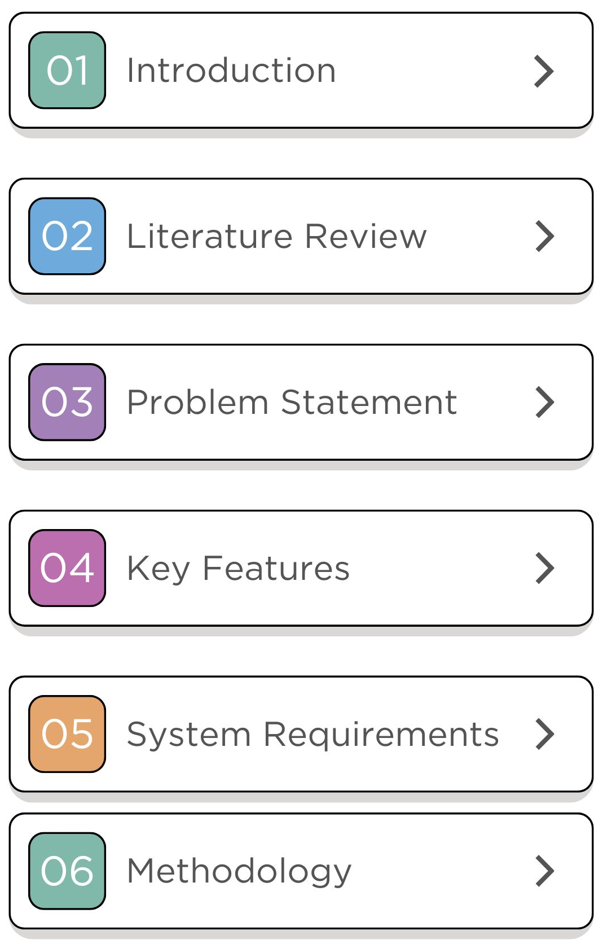
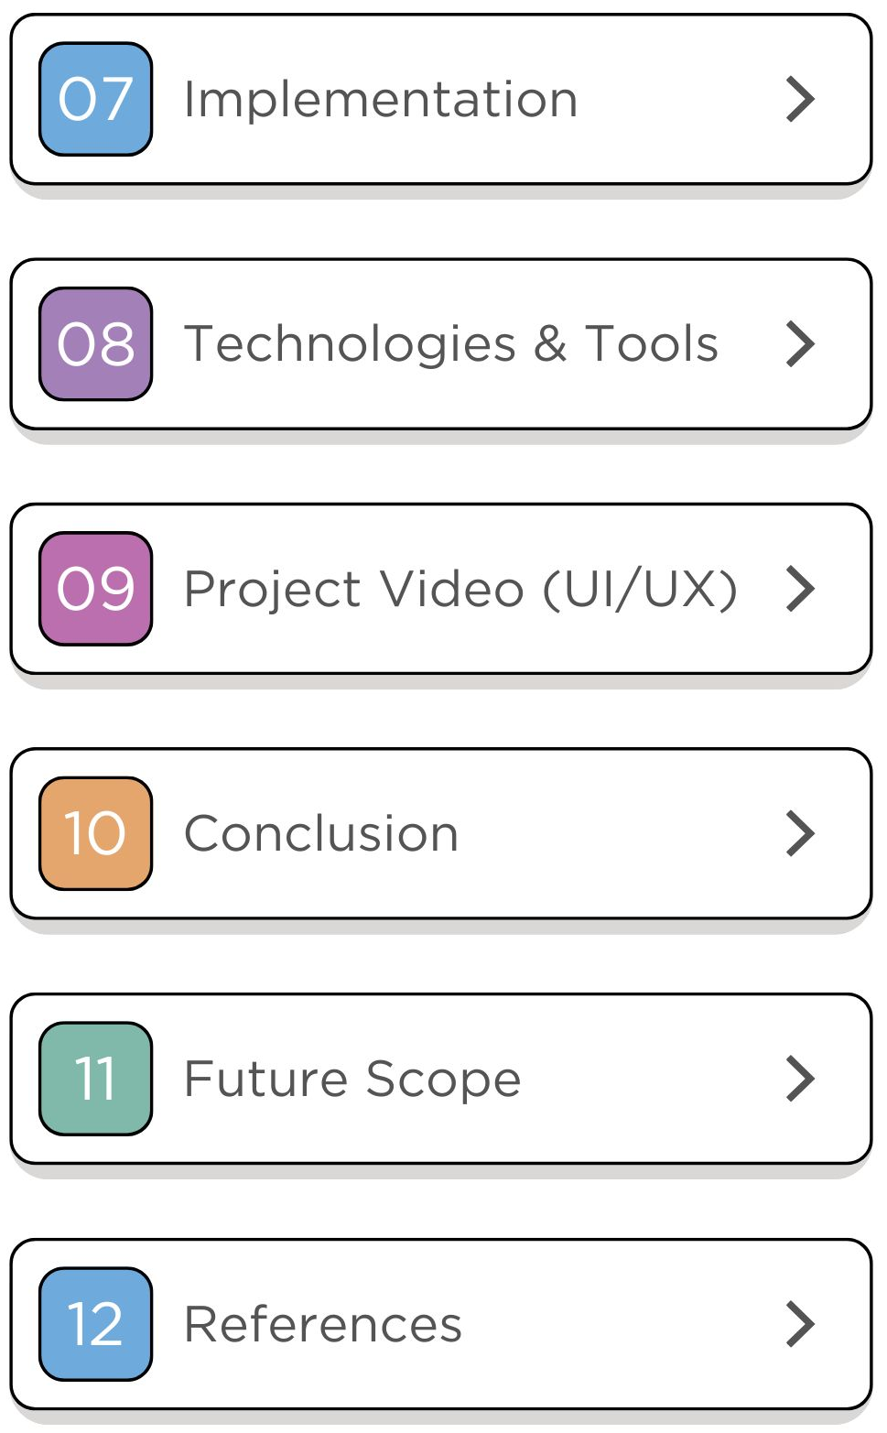
TABLE OF CONTENTS

Slide 4
01
INTRODUCTION

Slide 5

Diabetes is a chronic disease that requires patients to monitor their life make balanced diet and daily exercise routine. Our project aims to develop a personalized daily monitoring system that collects patients' health data and provides tailored recommendations to improve their lifestyle and overall health, helping to reduce complications.
Introduction

Slide 6

Diabetes Worldwide affect
90M
1 in 11 adults (90 million) are living with diabetes
Diabetes is major cause of death
diabetes management expending is about 827 billion USD globally

Slide 7


Literature Review
02

Slide 8

Machine Learning Models for Data-Driven Prediction of Diabetes by Lifestyle Type
The study evaluated five machine-learning models (CATBoost, XGBoost, Random Forest, Logistic Regression, and SVM) using data from 17,833 individuals in the (NHANES) database for diabetes prediction. Key lifestyle factors included energy, carbohydrate, and fat intake. (CATBoost) outperformed other models, achieving an accuracy of 82.1% and an AUC of 0.83. The findings highlight the potential of machine-learning models, especially CATBoost.
Publish Year | 2023
Algorithm | CATBoost
Accuracy | 82.1%
Dataset | NHANES

Slide 9
Predictive modelling and analytics for diabetes using a machine learning approach
The study applied machine learning to the Pima Indian diabetes dataset using R tools to predict diabetes and identify risk factors. Five supervised models were evaluated: SVM with linear and RBF kernels, k-Nearest Neighbor (k-NN), Artificial Neural Network (ANN), and Multifactor Dimensionality Reduction (MDR). The research emphasizes early diabetes detection to reduce risks like cardiac stroke and nephropathy, demonstrating the potential of ML for accurate predictions and healthcare improvements.
Publish Year | 2018
Algorithm | SVM
Accuracy | 77.3%
Dataset | PIMA

Slide 10
SACDNet: Towards Early Type 2 Diabetes Prediction with Uncertainty for Electronic Health Records
The study introduces SACDNet, a novel neural network for early T2DM prediction using self-attention layers, achieving 89.3% accuracy and 89.1% F1-Score. Monte Carlo Dropout is used for uncertainty quantification. Evaluations on a real-world EHR dataset (4,124 diabetic, 181,767 non-diabetic) and fairness analysis validate its effectiveness across demographics.
Publish Year | 2023
Algorithm | SACDNet
Accuracy | 89.3%
Dataset | EHR

Slide 11
Toward reliable diabetes prediction: Innovations in data engineering and machine learning applications
This study developed a data preprocessing pipeline and evaluated various ML algorithms on four diabetes datasets. Random Forest, XGBoost, and Decision Tree achieved top accuracies, with preprocessing boosting accuracy by 12.15%. These models show promise for accurate diabetes diagnosis, aiding in preventative healthcare efforts.
Publish Year | 2024
Algorithm | Decision tree
Accuracy | 99%
Dataset | Mendeley Diabetes Dataset

Slide 12
Pediatric diabetes prediction using deep learning
The study introduces a Deep Learning-based method for early diabetes prediction using a Multi-Layer Perceptron (MLP) model, tested on the Mansoura University Children's Hospital Diabetes (MUCHD) dataset. The model achieved 99.8% accuracy, with a 4.15% performance improvement over existing methods. Various validation techniques and metrics were employed, ensuring robust results. The approach is recommended as an effective tool for clinical diabetes forecasting and diagnosis.
Publish Year | 2024
Algorithm | DNN
Accuracy | 99.8%
Dataset | MUCHD

Slide 13
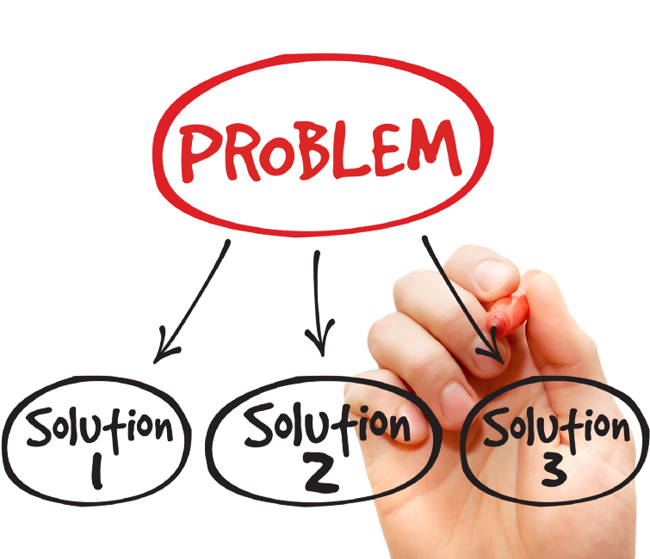
03
Problem Statement

Slide 14

Problems of Diabetes
Many diabetes patients lack personalized guidance on diet, exercise, and health.
Available sources are often general and do not fit individual patient conditions.
Lack of personalized guidance makes it difficult to make optimal health decisions and can lead to deteriorating health.

Slide 15

04
Key Features

Slide 16



Key Features
Personalized Diet Plans: Customized nutrition
Customized Exercise Routines: for better health
User-Friendly Interface: Intuitive design that facilitates easy navigation
AI: Advanced algorithms provide personalized tips based on medical guidelines and user data
Chatbot specifically designed to help diabetes patients

Slide 17

05
Requirements

Slide 18
Requirements
Functional Requirements
1. User Registration: Plans recommendation (Food).
2. Health Data Logging: Track glucose, diet, and exercise.
Non-Functional Requirements
1. Performance: Quick response times.
2. Scalability: Handle growing user base.
3. Usability: User-friendly design for all tech levels.

Slide 19

06
Methodology

Slide 20
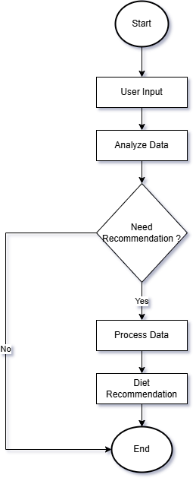
Methodology

Slide 21
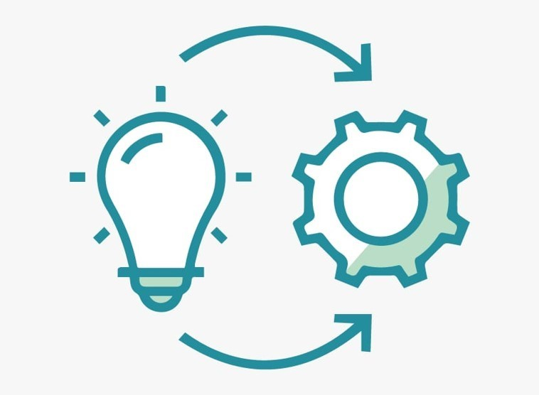
07
Implementation

Slide 22
Implementation
Data Collection:
1. Patient Data Source
Description: We started with a dataset containing real or simulated patient health indicators. The dataset included the following columns:
Column Name | Description
FastingBloodSugar | Blood glucose level after fasting
Systolic_BP | Upper blood pressure reading
Diastolic_BP | Lower blood pressure reading
LDL | "Bad" cholesterol level
HDL | "Good" cholesterol level
Triglycerides | Fat level in blood
Gender | Patient's gender
BMI | Body Mass Index
Age | Patient's age

Slide 23
Implementation
Data Collection:
2. Food Data Source
Collected & curated: By searching on Google Scholar.
Sources: USDA (nutrition info), ADA (diabetes guidelines), NHS (blood pressure-friendly foods), and verified nutrition websites.
Meal generation: Complete, nutritionally correct meals tailored to patient conditions.
Personalized matching: Meals were manually assigned for clinical relevance.

Slide 24
Implementation
Data Collection:
3. Custom Meal Assignment
Personalized meal plans :based on health profile.
Nutritional adjustments:
High blood sugar → Low GI, fiber-rich foods.
High LDL → Low-fat, HDL-boosting meals.
High blood pressure → Low sodium, potassium-rich choices.
Six daily meals per patient:
Breakfast: Fiber & protein-balanced.
Morning Snack: Light, low sugar.
Lunch: Controlled carbs & fats.
Afternoon Snack: Optional.
Dinner: Slow-digesting carbs.
Evening Snack: Stabilizes overnight blood sugar.

Slide 25
Implementation
Data Collection:
4. Final Dataset Format
The final dataset combined the health profile and the assigned meals in a single CSV file. It had the following columns:
Columns included:
Health indicators: FastingBloodSugar, Systolic_BP, Diastolic_BP, LDL, HDL, Triglycerides, Gender, BMI, Age.
Meal plan: Breakfast, Morning_Snack, Lunch, Afternoon_Snack, Dinner, Evening_Snack.
Structure: Each row represents one patient with their personalized full-day meal plan.

Slide 26
Implementation
Data Processing: Categorization and transformation of features.
Model Training: Multinomial logistic regression with SMOTE for balance.
Model Saving: Stored using joblib.
Meal Recommendations: Direct match and cosine similarity-based suggestions.
Prediction Execution: User input, sugar level prediction, and meal recommendations.

Slide 27
Implementation
Data Collection:
5. Exercise Data Source
Description: We collect health data and use AI to provide workout recommendations based on user profiles.
Steps:
Use dataset:
data
(/content/sample_5000.csv)
Dataset Contents
Dataset Contents:
Health Data: Gender, Age, BMI, Smoker, Heart Disease, Physical Activity, Difficulty Walking,
Healthcare Access
Workout Recommendations:
Workout1, Workout2, Workout3 with descriptions
Why Is It Suitable?
-Personalized workout recommendations based on health risks.
-Key health factors influencing exercise suitability.
-AI-powered fitness suggestions.
Usage
-Analyzes user data* to predict suitable workouts.
- Links health profiles* with tailored exercise plans.

Slide 28
Implementation
Preprocessing:
. Remove Duplicates: Ensures data integrity.
. Handle Missing Values:
- Numeric Columns: Filled using the mean.
- Categorical Columns: Filled with the most frequent value.
. Encode Categorical Variables: LabelEncoder applied to convert text labels to numeric format.
. Feature Scaling: StandardScaler normalizes numerical attributes for better similarity calculations
. Filter Rare Classes: Eliminates workouts appearing in fewer than 10 cases to ensure robust predictions.

Slide 29
Implementation
Model Training:
Steps:
Data Balancing: SMOTE applied to handle imbalanced workout classes.
Train-Test Split: 80% training, 20% testing
XGBoost Model Training: Optimized hyperparameters for accuracy.
Cross-Validation: Ensures model generalization.
Feature Importance Analysis: Determines key attributes influencing workout recommendations.

Slide 30

08
Technologies & Tools

Slide 31








Tools &Technologies
Html
CSS
JavaScript
Flask
Python
Kaggle
Visual Studio Code
Google Colab

Slide 32

09
UI/UX

Slide 33
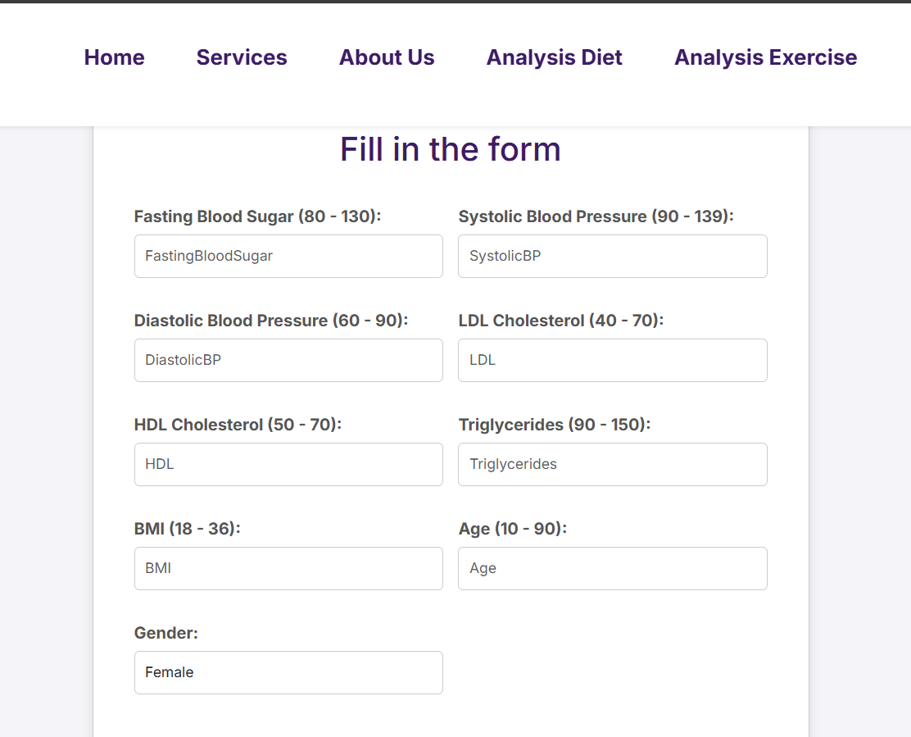
UI/UX
User Interface Design:
Description: Create an intuitive and user-friendly interface. When this interface is filled out, a suitable diet plan for the user will be displayed.
Steps:
1. Design a web interface for entering data and viewing health insights.
2. Provide charts and tables to track progress.

Slide 34
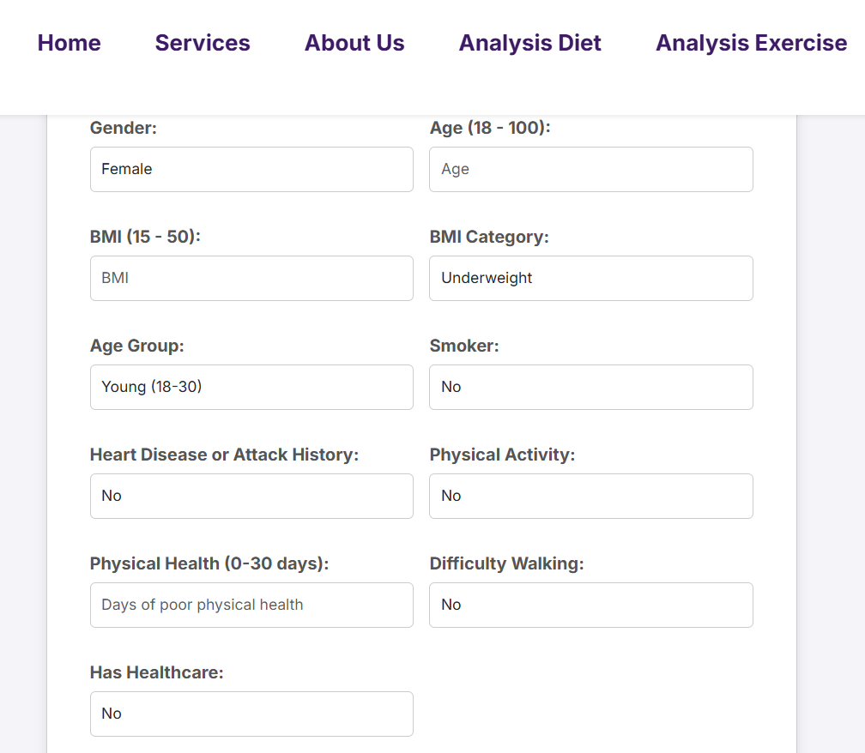
UI/UX
User Interface Design:
Description: This interface helps users input their data to customize an exercise plan.
Steps:
The user fills in their data like: gender ,BMI ,age.

Slide 35
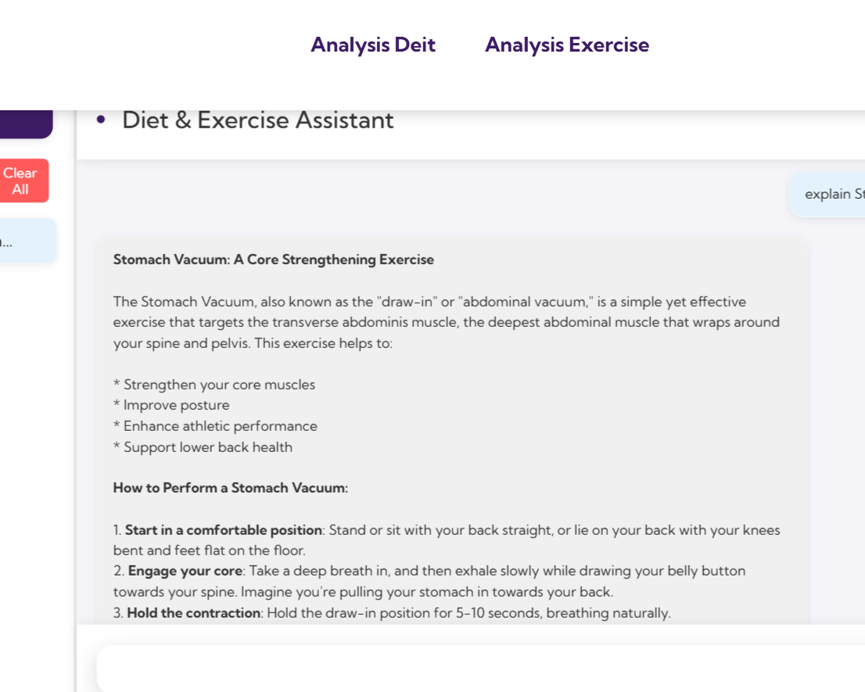
UI/UX
Chatbot:
Description: Create an interactive and user-friendly chatbot for seamless communication.
Steps:
1. Develop a chatbot interface for exchanging
messages and providing health insights.
2. Implement automated responses and data tracking
for personalized interaction.

Slide 36


10
Conclusion

Slide 37

Conclusion
Our project aims to develop a personalized system that analyzes health data and provides tailored recommendations for nutrition and exercise.
This helps patients make better decisions, improve their quality of life, and reduce complications, easing the burden on the healthcare system.

Slide 38

11
Future scope

Slide 39

Smart communication between doctor and patient
We will develop a system that provides exercise recommendations based on the user's health condition, offering personalized and safe fitness advice.

Slide 40

Gestational diabetes
The system helps doctors track blood sugar levels and alerts them to abnormal readings. Patients can enter data manually or via Bluetooth, receive check-up reminders, and get daily recommendations.

Slide 41
References
Paper 1
Yifan Qin, Jinlong Wu ,Zhanbing Ren
Medicine, Computer Science Link https://www.semanticscholar.org/paper/Machine-Learning-Models-for-Data-Driven-Prediction-Qin-Wu/5e6c58bb96e3f3ce5d5d35798f9f61c70054f57a
Paper 2
H. Kaur and V. Kumari. “Predictive modeling and analytics for diabetes using a machine learning approach,.” Appl Comput Informatics. 2018; Link https://www.emerald.com/insight/content/doi/10.1016/j.aci.2018.12.004/full/html
Paper 3
Tayyab Nasir, Muhammad Kamran Malik
https://arxiv.org/abs/2301.04844
Paper 4
Md. Alamin Talukder, Md Ashraf Uddin,Mohsin Kazi
383280844_Toward_reliable_diabetes_prediction_Innovations_in_data_engineering_and_machine_learning_applications
Paper 5
Abeer El-Sayyid El-Bashbishy , Hazem M El-Bakry
https://www.researchgate.net/publication/378339533_Pediatric_diabetes_prediction_using_deep_learning
Implementation
https://www.geeksforgeeks.org/random-forest-algorithm-in-machine-learning/
https://www.javatpoint.com/machine-learning-random-forest-algorithm

Slide 42
References
Source 1
USDA FoodData Central(https://fdc.nal.usda.gov/)
Source 2
American Diabetes Association (ADA)(https://www.diabetes.org/healthy-living/recipes-nutrition)
Source 3
Glycemic Index International Table(https://glycemicindex.com/)
Source 4
NHS – Healthy Eating Guidelines(https://www.nhs.uk/live-well/eat-well/ )

Slide 43



